Slide 1
Linear models in R
With continuous explanatory variables

Slide 2
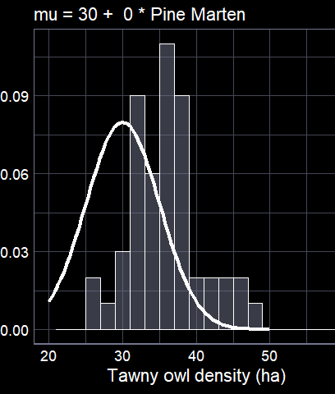
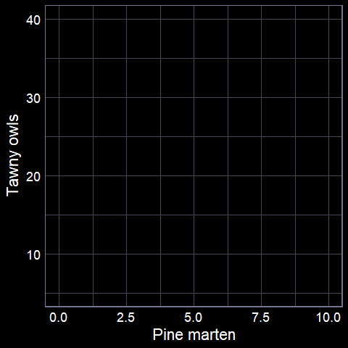

From theory to implementation

Slide 3
Step 1: The data

Slide 4
The core function
The entire previous lecture is summarised into a single
function in R
lm()
We need to give the function specific information
  The dataset
  The model formula

Slide 5
Make sure your data is ready
We want the data in “tabular” form
Where:
  each row is an observation
  each column is a variable
Easiest when data is entered this way from the start
  Otherwise you need to do lots of data processing (with potential mistakes)

Slide 6
Model formula
We want to understand how owl density changes with pine marten density
  Response variable = owl density
  Explanatory variable = marten density
To convey this to lm():
  owl ~ marten
  In English: “owl as a function of marten”
  In actual English: “Owl density changes with marten density”

Slide 7
Store your model
You can run the model each time you want to do something with it
  E.g. remind yourself what the parameter estimates were
But tedious and annoying
Easiest if you save your model output as an object
  Remember that “<-” stores (or “assigns”) output

Slide 8
Running the model
We ask the model to see if
there is any linear relationship
between tawny owl density and
pine marten density
Run a linear model
Call the stored
output “owl_model”
There is more
information
owl_model <- lm(tawny ~ marten,
data = owl_data)
Store the results
Use the “owl_data” dataset

Slide 9
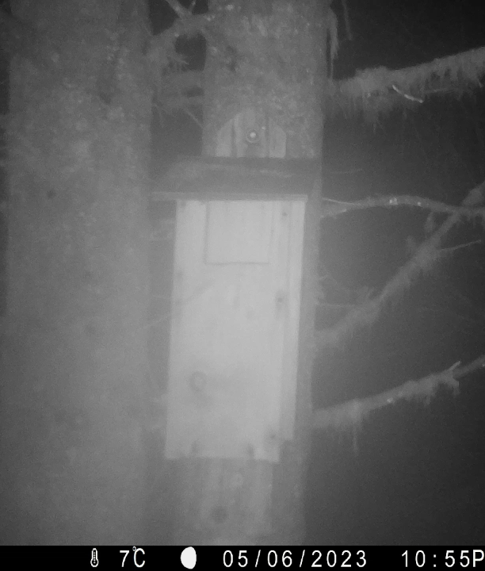

Now what?
Keep in mind, we’re not doing stats for the sake of it
We’re doing it to learn something about the world
Our current model has two parameters we want to learn
  Intercept ($β_{0}$)
  Slope ($β_{1}$)
How do we get that information?

Slide 10
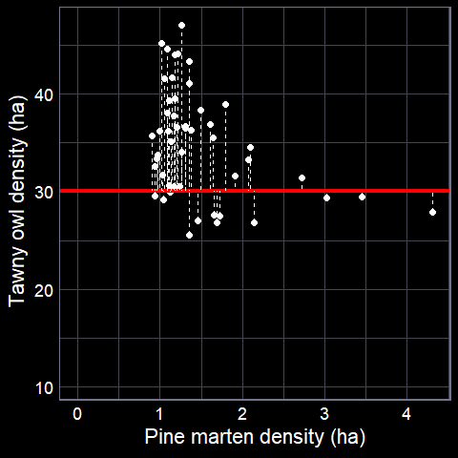
summary(owl_model)
Call:
lm(formula = tawny ~ marten, data = owl_data)
Residuals:
Min 1Q Median 3Q Max
-15.7312 -3.4267 0.0008 3.4721 14.1214
Coefficients:
Estimate Std. Error t value Pr(>|t|)
(Intercept) 39.4934 0.4239 93.16 <2e-16 ***
marten -3.0465 0.2780 -10.96 <2e-16 ***
---
Signif. codes: 0 ‘***’ 0.001 ‘**’ 0.01 ‘*’ 0.05 ‘.’ 0.1 ‘ ’ 1
Residual standard error: 5.015 on 1033 degrees of freedom
Multiple R-squared: 0.1042, Adjusted R-squared: 0.1033
F-statistic: 120.1 on 1 and 1033 DF, p-value: < 2.2e-16
Which model this is
Simple description of residuals
The biologically important parameter estimates

Slide 11
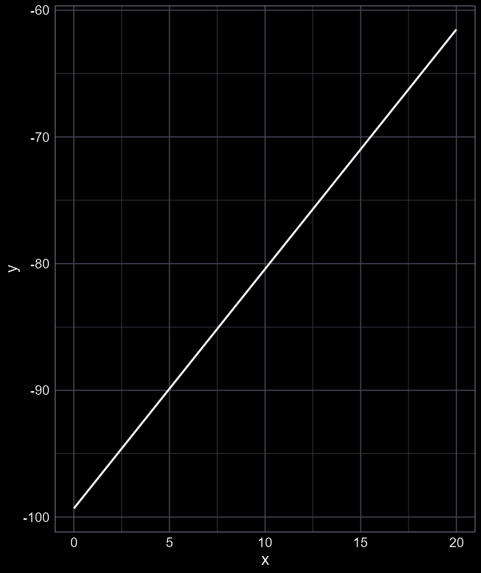

Make life easy for your audience
Reporting the actual parameter estimates is important
  Transparency and precision
But visualising the results is much more intuitive and helps non-technical readers to grasp the meaning
For example, which is easier:
  “$β_{0}$ was estimated at -99.32 and $β_{1}$ was estimated at 1.89”
  Or a figure?

